Slide 1
Geochemistry and Microbiology of the Photosynthetic Fringe
Taylor Walton
Everett shock
Notes:
Aiming for seven minute presentation

Slide 2
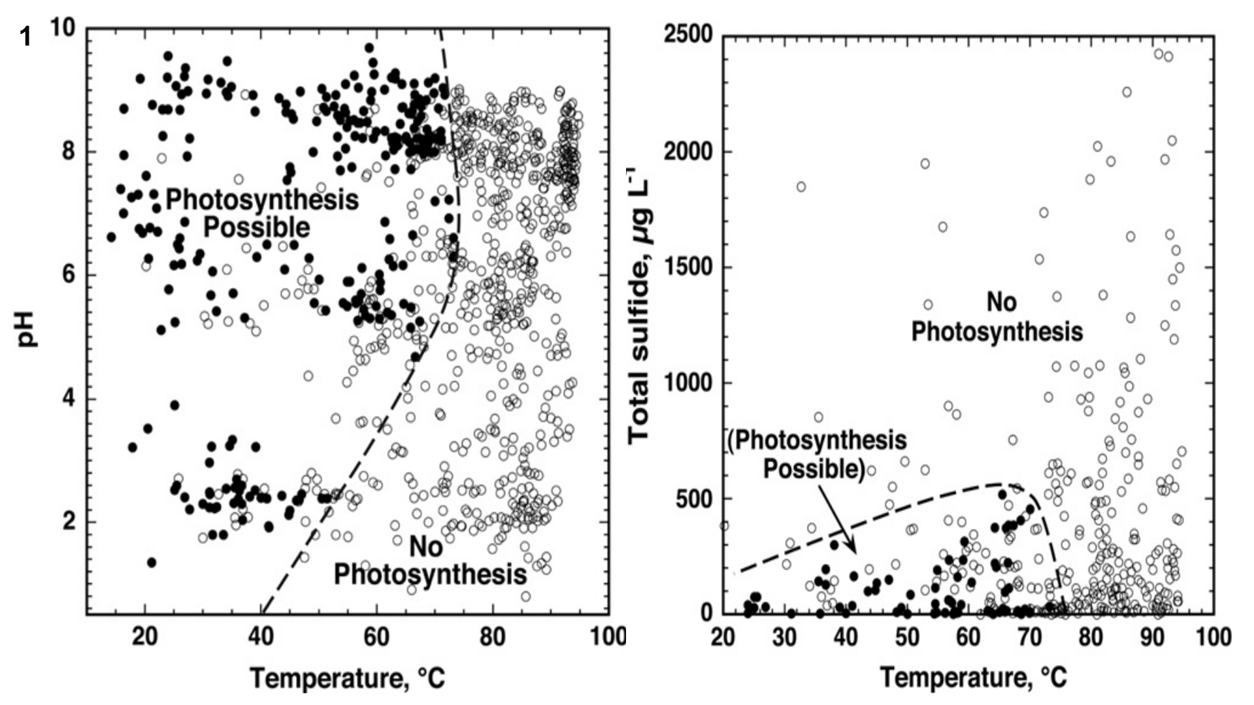
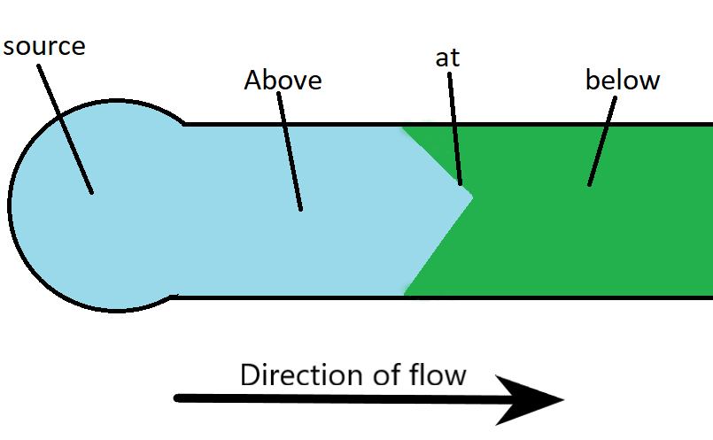
Aim
Notes:
What is the photosynthetic fringe? Well, cox et al (2011) sampled hot springs in YNP, and compared against the known limits for photosynthesis. The fringe lies near the handrawn lines seen there. Filled in =photosynthesis present

Slide 3
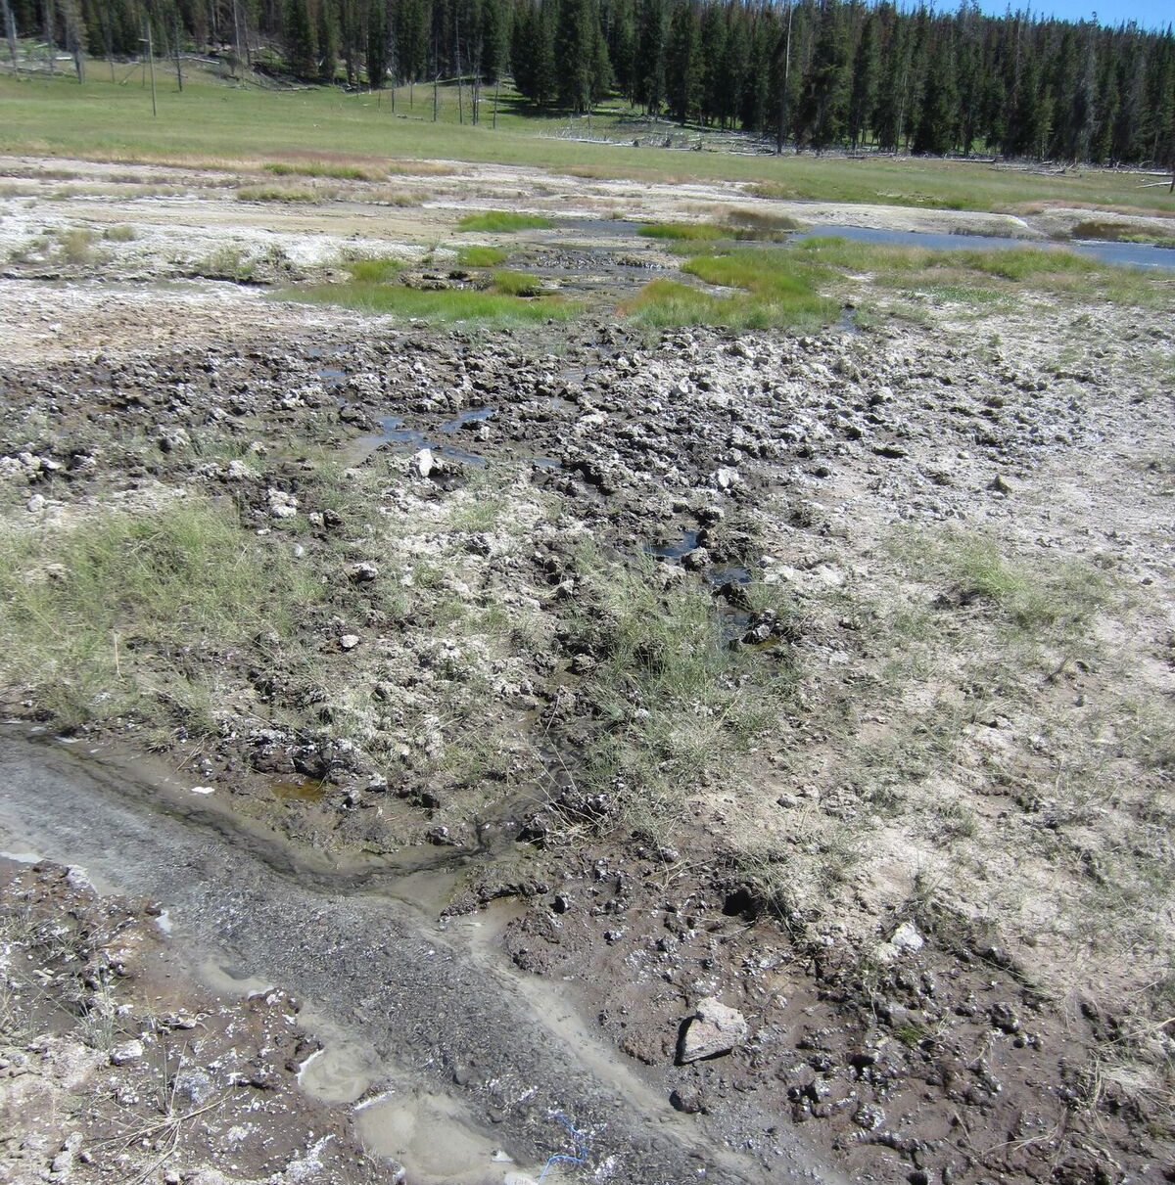
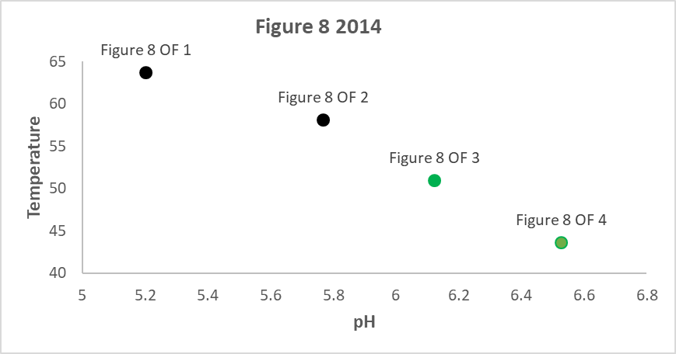
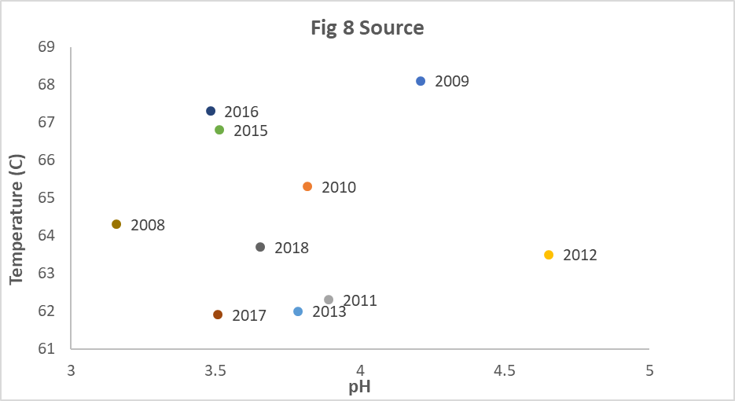
Figure 8
2
Notes:
Picture of fig 8, focused on OF 3 but can see the rest of it. Hot spring neat the famous Obsidian Pool in YNP. Work on figuring out layout—remove or add another graph here? Point is to show that this system is highly dynamic and changing constantly. Supports photosynthesis starting at OF 3 and 4—that’s why green.

Slide 4
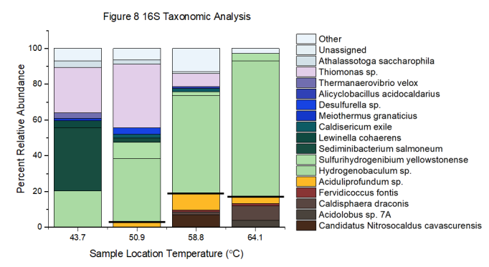
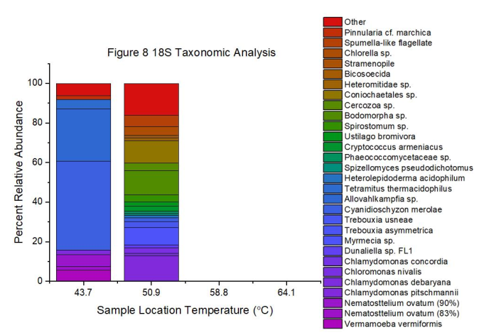
Biological data, 2014
OF4
OF3
OF2
OF1
OF4
OF3
1
Notes:
NO oxygenic photosynthesizing prokaryotes from the 16s in the cooler regions—where the fringe is. note THE only oxygenic phototrophs are eukaryotes! No cyanobacteria, but euks! Algae such as cyanidioschzyon merolae is a ‘red algae’ but does produce blue/green pigments (44% RA in OF4, 1.7% in OF3). Found in more acidic conditions (yes with a chloroplast). Chlamydamonas is a genus of green algae. It dominates in the OF3, but the C. merolae takes over downstream, curious. C. meerolae is known in hotsprings and adapted to higher sulfide, and is found in other photofringe sites. Highlighted the change in composition here. Candidatus Nitrosocaldus cavascurensis, brown at the borrom, in OF2 but missing from 1, 3, 4 is a known ammonia oxidizer.

Slide 5
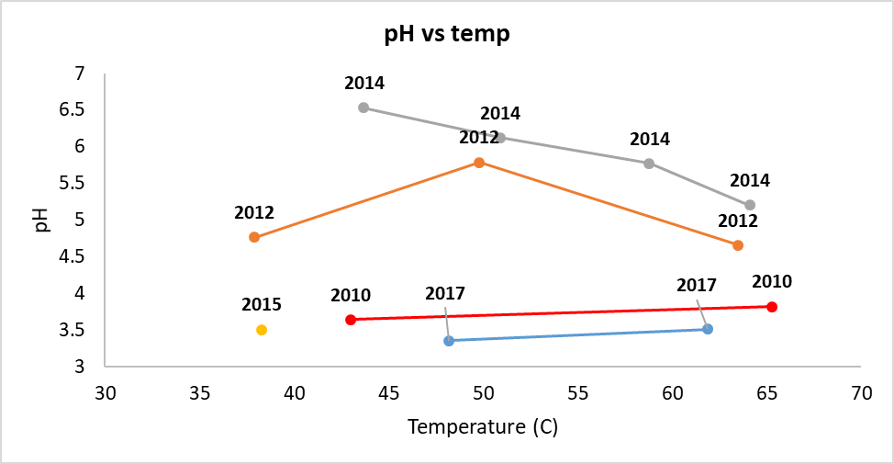
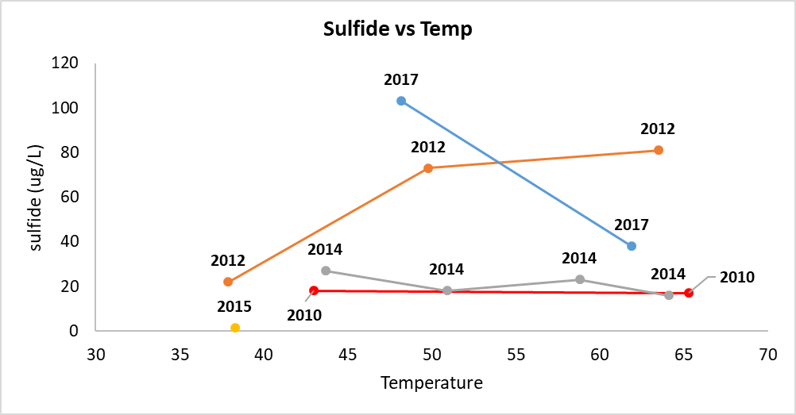
Geochemistry
Notes:
Using data from 10 years of water samples, these particular 5 years had enough data in order to calculate energy available for NH3 oxidation. So refer back to the cox et al plot, it is clear that all these sites fall well below the sulfide limit, and many fall within the temp ph range

Slide 6
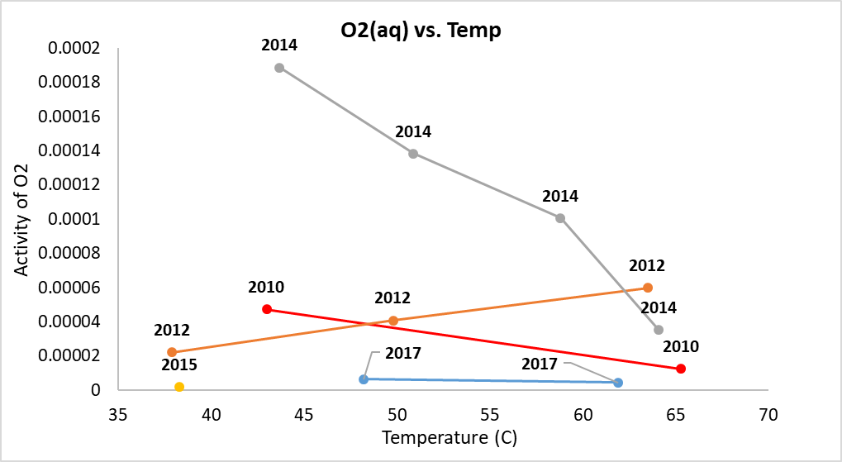
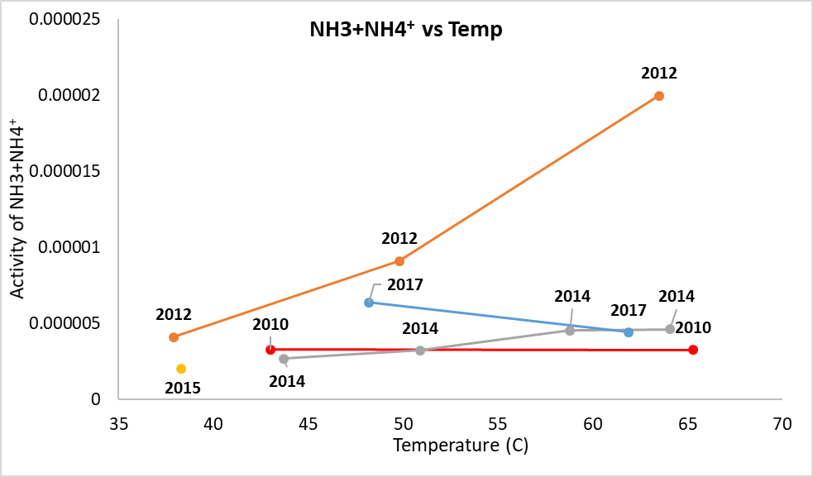
Geochemical water composition results
Ammonia oxidation
NH₄⁺ + NH₃(aq) + 4O₂→ 2NO₃⁻ +3H⁺ + 2H₂O
Notes:
Constituents for ammonia oxidation. NOTE: the equation includes NH3, because NH3 can also be oxidized. Why do we care? Well NH4 is important for algal growth, though NO3 can also be used as a N source (proteins!)

Slide 7
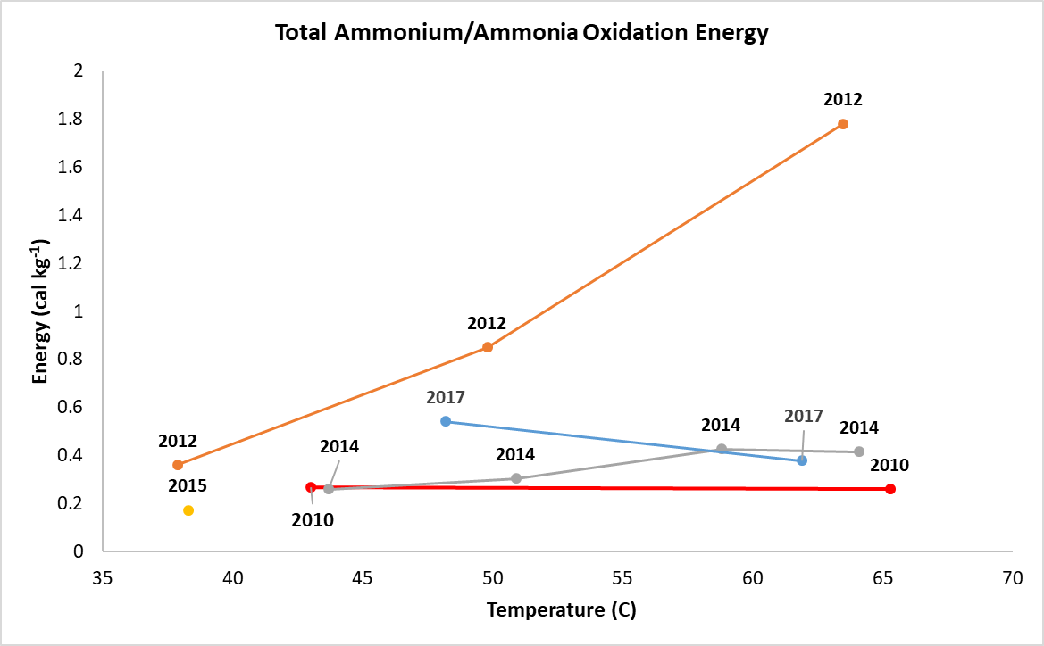
Energy modeling results
Ammonia oxidation
NH₄⁺ + NH₃(aq) + 4O₂→ 2NO₃⁻ +3H⁺ + 2H₂O
Notes:
Energy for NH3 oxidation changes drastically over time! Not by insignificant amounts either! In 2017 energy increases down the outflow, but in 2012 and 2014 it decreases. Was relatively constant in 2010! NOTE: NH3 is very, very low in this system (activity is in the E-10 range…), and thus the reaction is really just NH4 being oxidized here. Should I change this?
Why focus on Nh3/NH4 oxidation? Romero, 2018 indicated that this was highest energy available in figure 8 in 2014.. Nitrogen is also a key element for life, and it is highly sought after. Perhaps competition keeps prokaryotes out, and the euks are better able to cope? One possible explanation here

Slide 8
Next Steps
Sequence the Metagenome of the 2014 fringe samples
  Investigate the community diversity more thoroughly
  Investigate all the metabolic pathways that could be used via whole genome assembly
  Compare this data against energy calculations for 2014
16srRNA sequencing on the remaining figure 8 samples if available
  To understand the year-to-year change in community, if applicable
  Microbes present here can be used to determine what metabolisms withstand the changes
Notes:
Note, if I do spend the time to BLAST the unknown 16s samples before submitting then incorporate here. Otherwsie make a note of it here

Slide 9



Acknowledgements
I’d like to thank the ASU/NASA Space Grant Program, My mentor Dr. Everett Shock and the following members of the GEOPIG Research team for their assistance: Alta Howells, Katelyn Weekes, and Jordyn Robare

Slide 10
References
¹Cox A, Shock E, Havig J (2011) The transition to microbial photosynthesis in hot spring ecosystems. Chemical Geology 280: 344-351.
²Romero, J. T. (2018). Changes in microbial communities and geochemical energy supplies across the photosynthetic fringe of hot spring outflows in Yellowstone national park (Order No. 10981678). Available from Dissertations & Theses @ Arizona State University; ProQuest Dissertations & Theses Global. (2155990428).

